Slide 1
Packages and Interfaces

Slide 2
Packages
A java package is a group of similar types of classes, interfaces and sub-packages.
Packages are containers for classes that are used to keep the class name space compartmentalized.
Packages are used in Java in order to prevent naming conflicts, to control access, to make searching/locating and usage of classes, interfaces, enumerations and annotations easier, etc.
Package in java can be categorized in two form, built-in package and user-defined package.
There are many built-in packages such as java, lang, awt, javax, swing, net, io, util, sql etc.

Slide 3
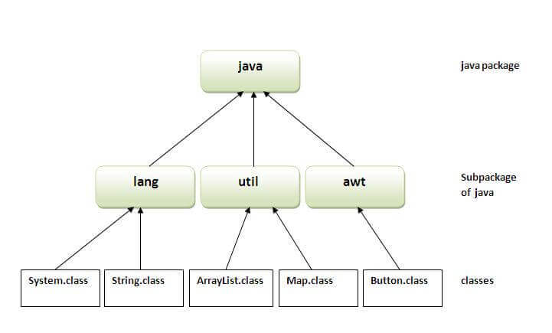
Advantage of Java Package
1) Java package is used to categorize the classes and interfaces so that they can be easily maintained.
2) Java package provides access protection.
3) Java package removes naming collision.

Slide 4
Built-in Packages
These packages consist of a large number of classes which are a part of Java API.Some of the commonly used built-in packages are:
1) java.lang: Contains language support classes(e.g classed which defines primitive data types, math operations). This package is automatically imported.
2) java.io: Contains classed for supporting input / output operations.
3) java.util: Contains utility classes which implement data structures like Linked List, Dictionary and support ; for Date / Time operations.
4) java.applet: Contains classes for creating Applets.
5) java.awt: Contain classes for implementing the components for graphical user interfaces (like button , menus etc).
6) java.net: Contain classes for supporting networking operations.
To import a package
import package.name.*;

Slide 5
import java.util.*;
// Main Class
class GFG {
// Main driver method
public static void main(String[] args)
{
// Scanner to take input from the user object
Scanner myObj = new Scanner(System.in);
String userName;
// Display message
// Enter Your Name And Press Enter
System.out.println("Enter You Name");
// Reading the integer age entered using
// nextInt() method
userName = myObj.nextLine();
// Print and display
System.out.println("Your Name IS : " + userName);
}
}
OUTPUT
Enter You Name AAA
Your Name IS : AAA

Slide 6
Defining a Package
To create a package is quite easy: simply include a package command as the first statement in a Java source file.
Any classes declared with in that file will be long to the specified package.
The package statement defines a name space in which classes are stored.
If you omit the package statement, the class names are put into the default package, which has no name.
package pkg;
Here, pkg is the name of the package.

Slide 7
Now in order to create a package in java follow the certain steps as described below:
First We Should Choose A Name For The Package We Are Going To Create And Include. The package command In The first line in the java program source code.
Further inclusion of classes, interfaces that is required in the package can be made in the package. For example, the below single statement creates a package name called “FirstPackage”.
The general form of a multileveled package statement is shown here:
package pkg1[.pkg2[.pkg3]];
For example, a package declared as
package java.awt.image;
needs to be stored in java\awt\image in a Windows environment.

Slide 8
// Name of package to be created
package FirstPackage;
// Class in which the above created package belong to
class Welcome {
// main driver method
public static void main(String[] args)
{
// Print statement for the successful
// compilation and execution of the program
System.out.println(“Geeks For Geeks..");
}
}
Procedure:
1. To generate the output from the above program
Command: javac Welcome.java
2. The Above Command Will Give Us Welcome.class File.
Command: javac -d . Welcome.java
3. So This Command Will Create a New Folder Called FirstPackage.
Command: java FirstPackage.Welcome
Output: The Above Will Give The Final Output Of The Example Program
Geeks For Geeks

Slide 9
// Name of package to be created
package data;
// Class to which the above package belongs
public class Demo {
// Member functions of the class- 'Demo'
// Method 1 - To show()
public void show()
{
// Print message
System.out.println("Hi Everyone");
}
// Method 2 - To show()
public void view()
{
// Print message
System.out.println("Hello");
} }
1. To generate the output from the above program
Command: javac Demo.java
2. This Command Will Give Us a Class File
Command: javac -d . Demo.java
3. So This Command Will Create a New Folder Called data.

Slide 10
// Name of the package
import data.*;
// Class to which the package belongs
class ncj {
// main driver method
public static void main(String arg[])
{
// Creating an object of Demo class
Demo d = new Demo();
// Calling the functions show() and view()
// using the object of Demo class
d.show();
d.view();
}
}
Command: javac Demo.java
Command: java ncj // To Run This File
Hi Everyone
Hello

Slide 11
Finding Packages and CLASSPATH
1. First, by default, the Java run-time system uses the current working directory as its starting point. Thus, if your package is in a subdirectory of the current directory, it will be found.
2. Second, you can specify a directory path or paths by setting the CLASSPATH environmental variable.
3. Third, you can use the -classpath option with java and javac to specify the path to your classes.

Slide 12
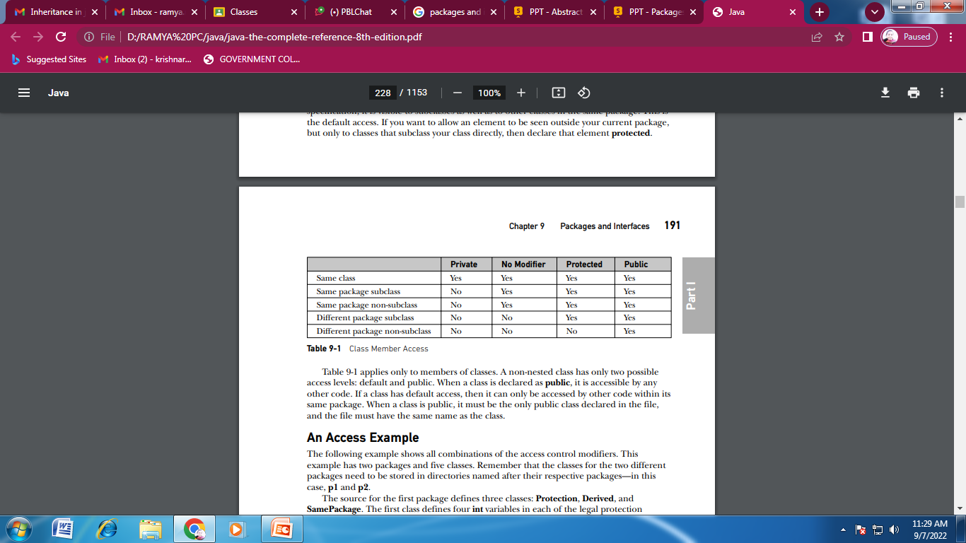
Access Protection

Slide 13
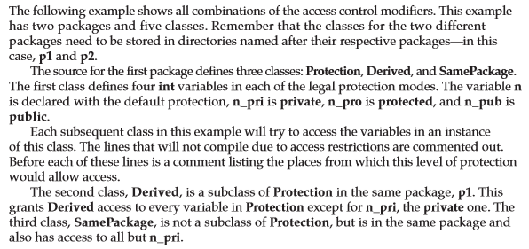

An Access Example

Slide 14
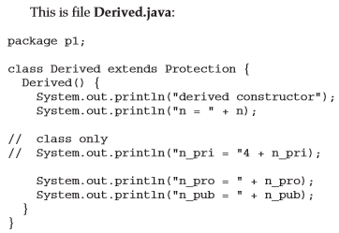
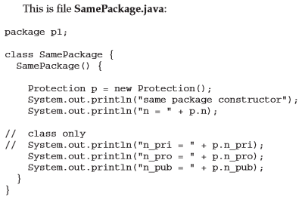
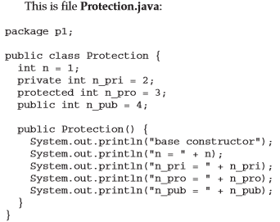
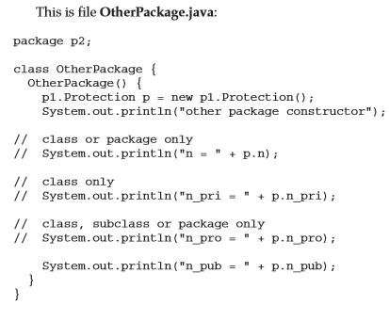
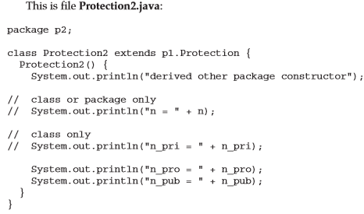

Slide 15
Importing Packages
Since classes within packages must be fully qualified with their package name or names, it could be come tedious to type in the long dot-separated package path name for every class you want to use.
For this reason, Java includes the import statement to bring certain classes, or entire packages, into visibility.
Once imported, a class can be referred to directly, using only its name.
If you are going to refer to a few dozen classes in your application, however, the import statement will save a lot of typing.
In a Java source file, import statements occur immediately following the package statement (if it exists)and before any class definitions.
  import pkg1[.pkg2].(classname|*);
Here, pkg1 is the name of a top-level package, and pkg2 is the name of a subordinate package inside the outer package separated by a dot (.).
There is no practical limit on the depth of a package hierarchy, except that imposed by the file system.
Finally, you specify either an explicit class name or a star(*), which indicates that the Java compiler should import the entire package.
import java.util.Date;
import java.io.*;

Slide 16
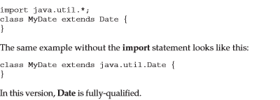
All of the standard Java classes included with Java are stored in a package called java.
The basic language functions are stored in a package inside of the java package called java.lang.
Normally, you have to import every package or class that you want to use, but since Java is useless without much of the functionality in java.lang, it is implicitly imported by the compiler for all programs.
import java.lang.*;
If a class with the same name exists in two different packages that you import using the star form, the compiler will remain silent, unless you try to use one of the classes.
In that case, you will get a compile-time error and have to explicitly name the class specifying its package.
It must be emphasized that the import statement is optional.
Any place you use a class name, you can use its fully qualified name, which includes its full package hierarchy.

Slide 17
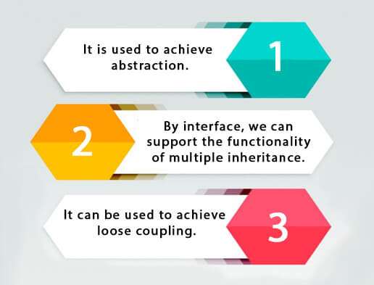
Interfaces
An interface in Java is a blueprint of a class. It has static constants and abstract methods.
The interface in Java is a mechanism to achieve abstraction. There can be only abstract methods in the Java interface, not method body. It is used to achieve abstraction and multiple inheritance in Java.
Why use Java interface?

Slide 18
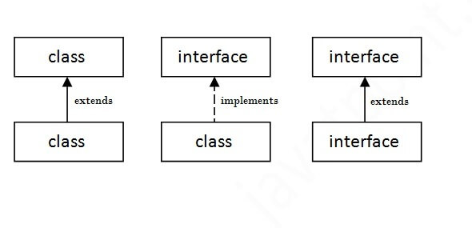
Defining an Interface
An interface is defined much like a class. This is the general form of an interface:
interface <interface_name>{
// declare constant fields
// declare methods that abstract
// by default.
}

Slide 19
Java Interface Example
interface printable{
void print();
}
class A6 implements printable{
public void print(){System.out.println("Hello");}
public static void main(String args[]){
A6 obj = new A6();
obj.print();
}
}

Slide 20
interface Drawable{
void draw();
}
//Implementation: by second user
class Rectangle implements Drawable{
public void draw(){System.out.println("drawing rectangle");}
}
class Circle implements Drawable{
public void draw(){System.out.println("drawing circle");}
}
//Using interface: by third user
class TestInterface1{
public static void main(String args[]){
Drawable d=new Circle();//In real scenario, object is provided by method e.g. getDrawable()
d.draw();
}}

Slide 21
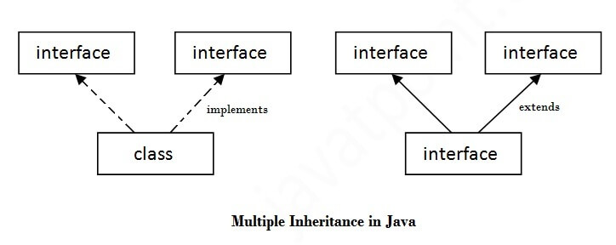
Multiple inheritance in Java by interface
If a class implements multiple interfaces, or an interface extends multiple interfaces, it is known as multiple inheritance.

Slide 22
interface Printable{
void print();
}
interface Showable{
void show();
}
class A7 implements Printable,Showable{
public void print(){System.out.println("Hello");}
public void show(){System.out.println("Welcome");}
public static void main(String args[]){
A7 obj = new A7();
obj.print();
obj.show();
}
}

Slide 23
Interface inheritance
A class implements an interface, but one interface extends another interface.
interface Printable{
void print();
}
interface Showable extends Printable{
void show();
}
class TestInterface4 implements Showable{
public void print(){System.out.println("Hello");}
public void show(){System.out.println("Welcome");}
public static void main(String args[]){
TestInterface4 obj = new TestInterface4();
obj.print();
obj.show();
}
}

Slide 24
Default Method in Interface
interface Drawable{
void draw();
default void msg(){System.out.println("default method");}
}
class Rectangle implements Drawable{
public void draw(){System.out.println("drawing rectangle");}
}
class TestInterfaceDefault{
public static void main(String args[]){
Drawable d=new Rectangle();
d.draw();
d.msg();
}}

Slide 25
Static Method in Interface
interface Drawable{
void draw();
static int cube(int x){return x*x*x;}
}
class Rectangle implements Drawable{
public void draw(){System.out.println("drawing rectangle");}
}
class TestInterfaceStatic{
public static void main(String args[]){
Drawable d=new Rectangle();
d.draw();
System.out.println(Drawable.cube(3));
}}

Slide 26
Nested Interface in Java
An interface can have another interface which is known as a nested interface. We will learn it in detail in the nested classes chapter. For example:
interface printable{
void print();
interface MessagePrintable{
void msg();
}
}

Slide 27
interface Showable{
void show();
interface Message{
void msg();
}
}
class TestNestedInterface1 implements Showable.Message{
public void msg(){System.out.println("Hello nested interface");}
public static void main(String args[]){
Showable.Message message=new TestNestedInterface1();//upcasting here
message.msg();
}
}

Slide 28
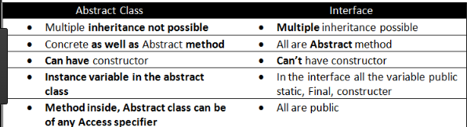

Slide 29
Abstract class | Interface
1) Abstract class can have abstract and non-abstract methods. | Interface can have only abstract methods. Since Java 8, it can have default and static methods also.
2) Abstract class doesn't support multiple inheritance. | Interface supports multiple inheritance.
3) Abstract class can have final, non-final, static and non-static variables. | Interface has only static and final variables.
4) Abstract class can provide the implementation of interface. | Interface can't provide the implementation of abstract class.
5) The abstract keyword is used to declare abstract class. | The interface keyword is used to declare interface.
6) Example: public abstract class Shape{ public abstract void draw(); } | Example: public interface Drawable{ void draw(); }

